Slide 1
Casper: Query Processing for Location Services
without Compromising Privacy
Nikhil Kumar Md Rehan Zeya

Slide 2
Problem Statement
Input:
User Exact Location
User Privacy Profile
(K, A min)
K - You are anonymous among k
A - Min area (User Privacy Area means cloaked region for this user must be of this area or larger containing K users )
Output:
Candidate list
(Entertainment centres)

Slide 3
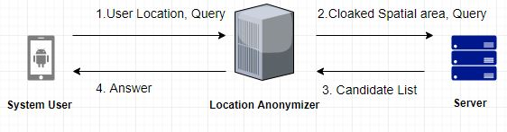
Casper System Architecture
The privacy-aware query processor is embedded inside the Database server.
Query: Nearest Target Object to the user exact pin location.

Slide 4
Experimental Setup
Language: C++
GIS Visualization: QGIS Desktop Software
Windows: 8.1
CPU Cycles: 1.7 GHz
For finding cloaked region for users, we have made three experiments
Varying K value
Varying Area
Varying #Users

Slide 5
Dataset - City of Milan, Italy
We are using User Movement Simulations dataset by University of Milan
#Users = 1,00,000
#POI = 1280 (Entertainment Centres like Pubs, Malls etc)
We have taken for 10 Time frames to see user movement and update our pyramid with current user location.
Using Minimum Splitting area to denote the area at the lowest level of pyramid in basic algorithm.

Slide 6
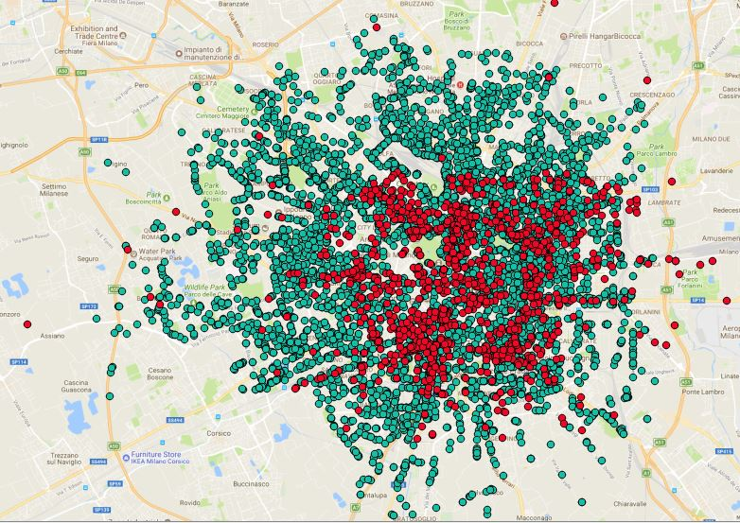

Slide 7
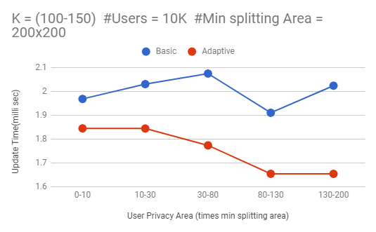

Slide 8
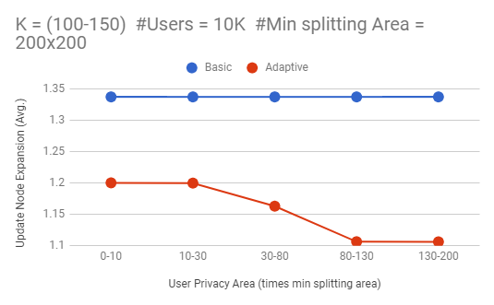

Slide 9
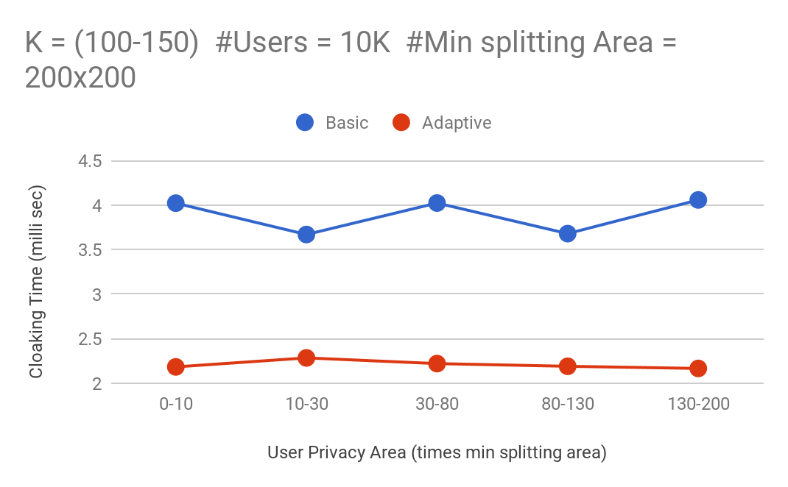

Slide 10
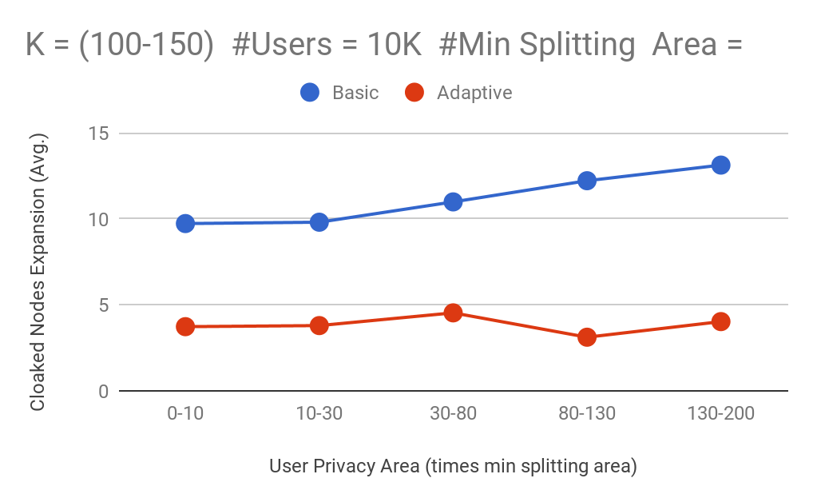

Slide 11
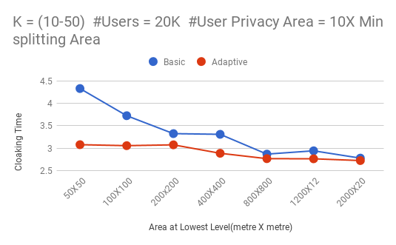

Slide 12
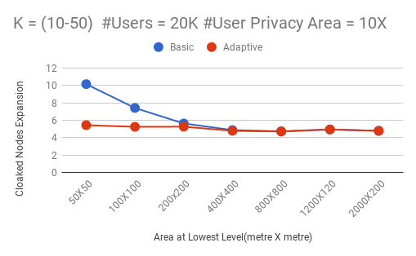

Slide 13
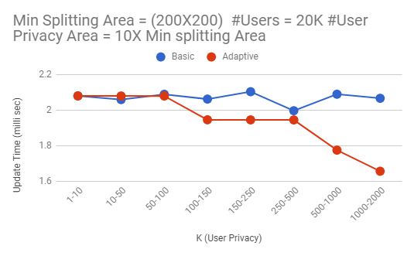

Slide 14
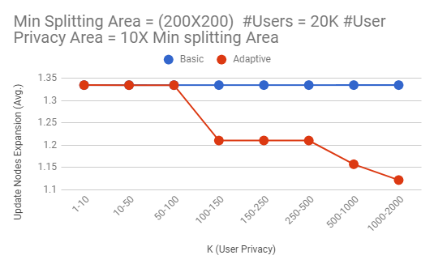

Slide 15
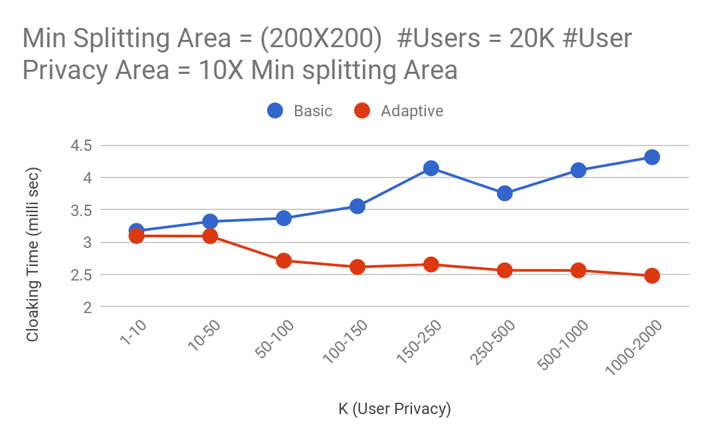

Slide 16
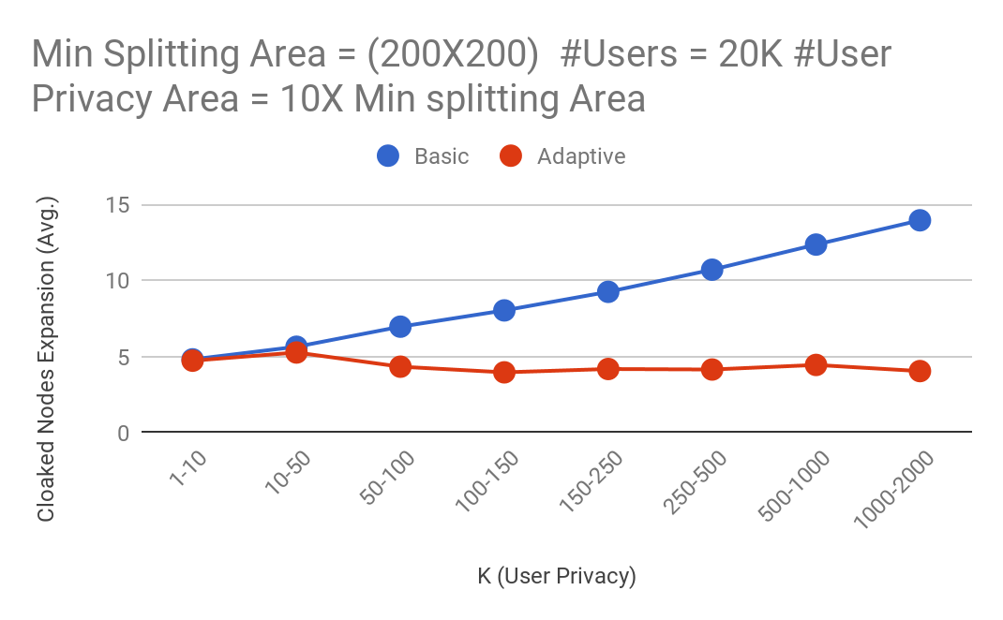

Slide 17
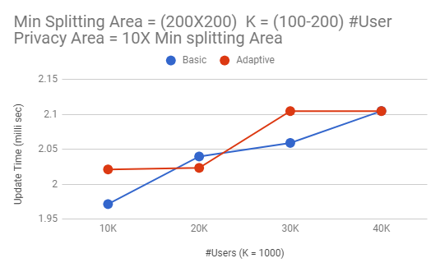

Slide 18
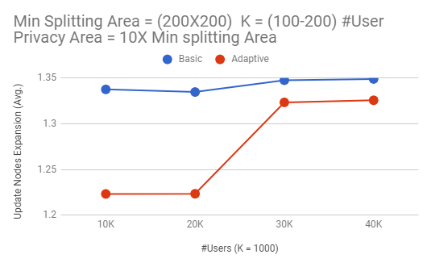

Slide 19
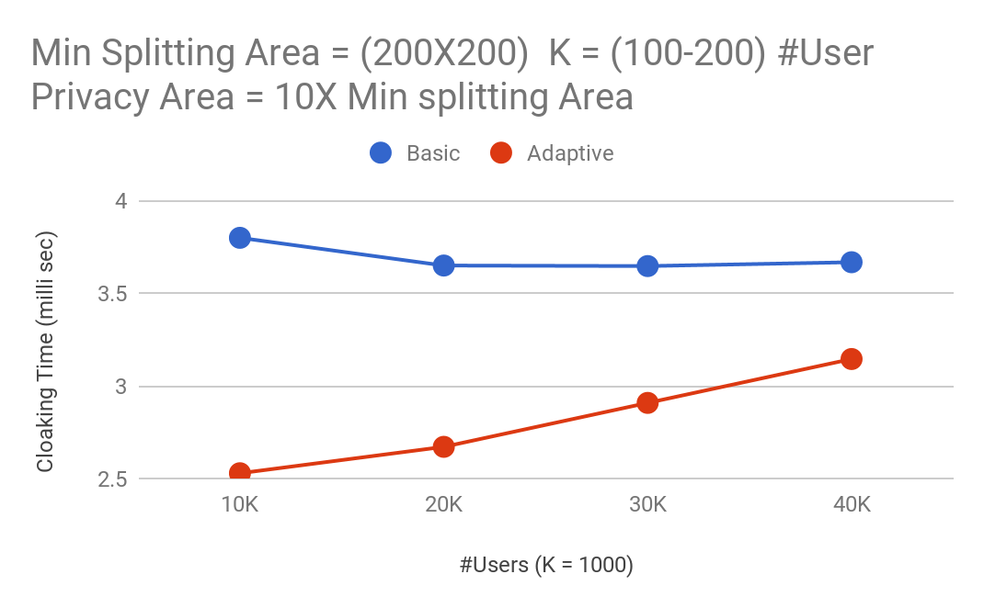

Slide 20
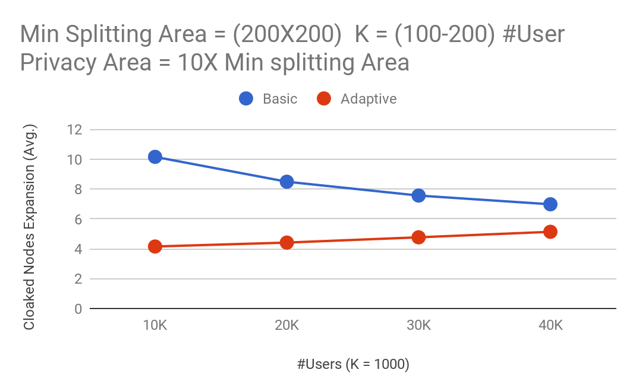

Slide 21
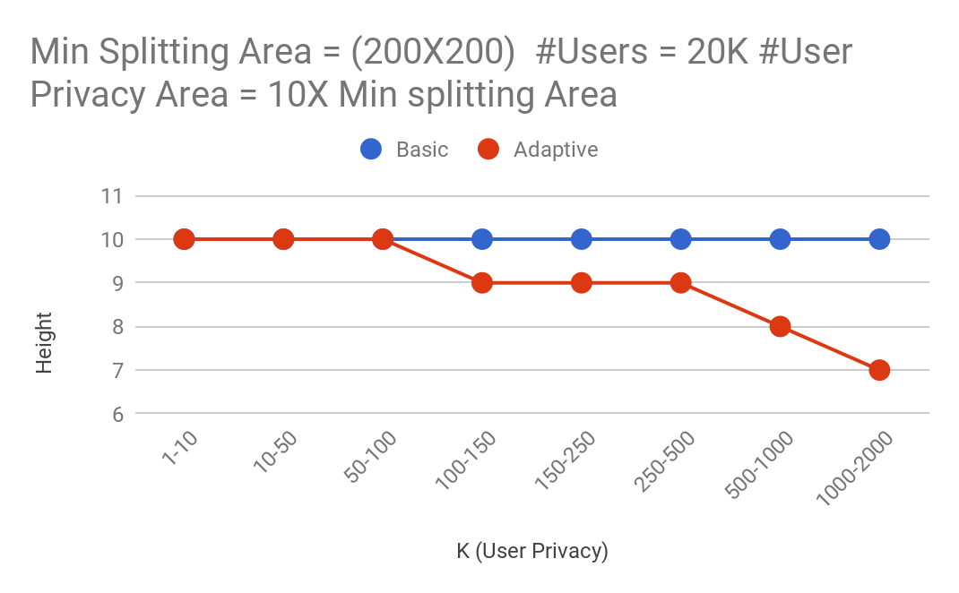

Slide 22
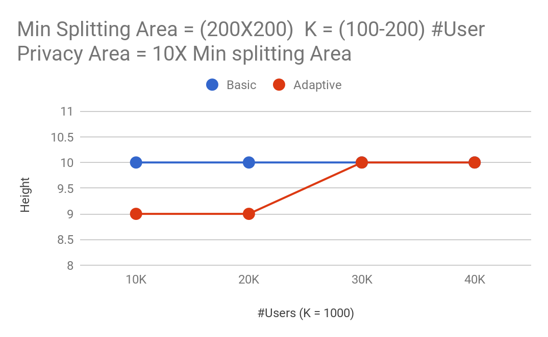

Slide 23
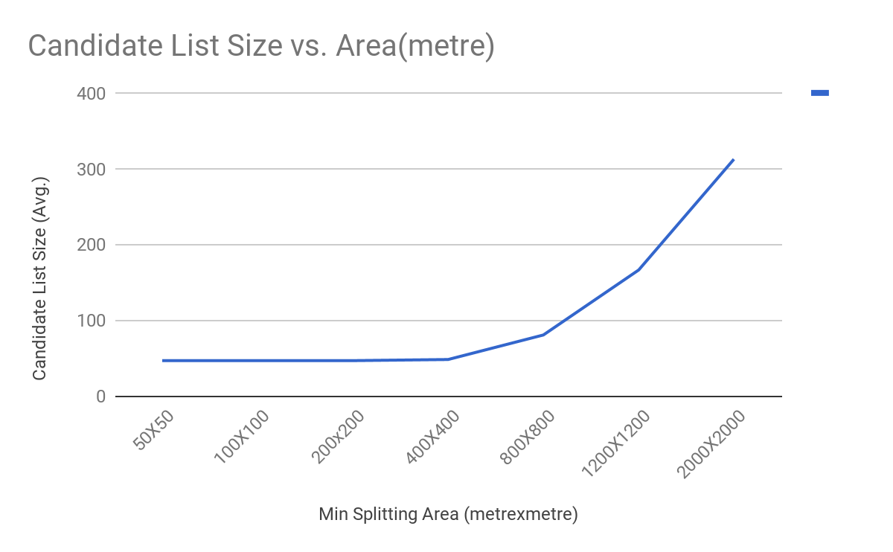

Slide 24
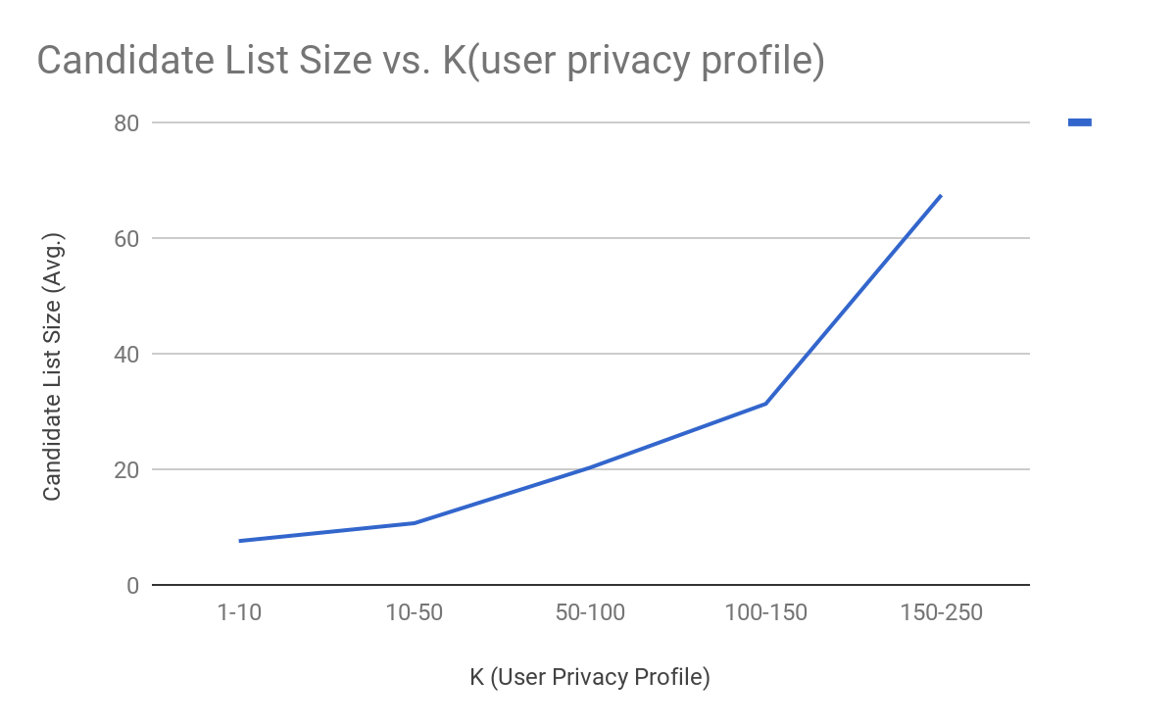

Slide 25
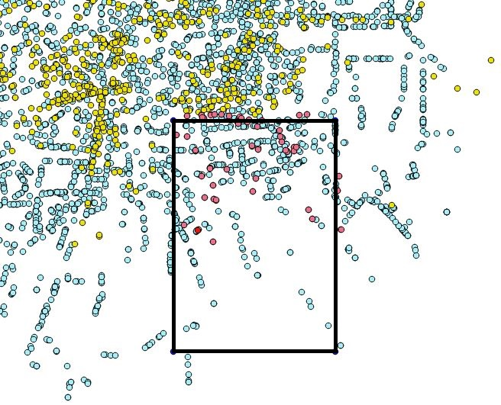
Final Result

